Slide 1

Demystifying the World of AI: Making Sense of a Global Shift in HR
HR Without Boundaries
Rethinking Organizational Design for a Dynamic Workforce
Demystifying the World of AI: Sense of a Global Shift in HR
November 2025
Notes:
What makes the workforce dynamic… is it the location, the development or evolution of their skills,
Perhaps it’s the mindset that drives their interaction, the relationship, and workflow connection points?
When and where does HR lean in the Organizational Design process?

Slide 2
Quotes are a great way to break up presentation sections. They can be placed over solid colored or photo backgrounds.
If too “busy looking” then place a colored box over the photo at around 80% transparency.
Today’s Topic
The Truth About AI and Clarifying Misconceptions About AI in HR, Compliance, Benefits, and Beyond

Slide 3


Today’s Agenda
01. What the public gets right – and wrong – about AI’s impact for businesses and employees
02. Is AI the salvation proponents swear it is, or does it just benefit from great public perception?
03. Common misconceptions you need to know about AI
04. Forward thinking AI
©2024 Vensure Employer Services

Slide 4

The World of AI

Slide 5

According to S&P
Global Market Intelligence
Companies abandoning most AI initiatives jumped from 17% in 2024 to 42% this year. Meanwhile, employees who frequently use AI report 45% higher burnout rates compared to those who rarely use it, based on a study by Quantum Workplace.

Slide 6
What is AI, Really?
Patterns
Data
Machine Learning
Automation
AI is a tool, not a magic wand

Slide 7
Automation vs AI
Amplifies good processes, worsens bad ones
AI as a multiplexer
Power Automate
Notes:
Automation follows predefined rules. It’s like a recipe — the system does the same steps every time, quickly and accurately, but it doesn’t “think.”
AI uses learning and reasoning. It can make decisions, adapt to new situations, and even improve over time based on data — more like a digital coworker than a tool.
Automation = “Do exactly this.”
AI = “Figure out the best way to do this.”

Slide 8
Examples of Automation & AI
Automation
Robotic Process Automation (RPA) for invoice approvals (e.g., UiPath)
Email and marketing workflow automation (e.g., HubSpot, Zapier)
Warehouse robotics for order fulfillment (e.g., Amazon Kiva robots)
IT infrastructure auto-scaling and backups (e.g., AWS Lambda scripts)
Payroll processing and tax filing systems (e.g., ADP, Gusto)
AI
Customer support chatbots that autonomously resolve tickets
AI copilots for coding and productivity (e.g., GitHub Copilot, Microsoft Copilot)
Fraud detection models that adapt to new patterns (e.g., Mastercard AI)
Agentic workflow orchestrators that plan and execute multi-step tasks (e.g., AutoGPT, Devin AI)

Slide 9
Vensure’s Approach
  Process-driven structure: ideal for automation
  Reducing screen time, increasing stakeholder engagement
  Enhancing user experience and job performance
  Examples of AI Use at Vensure
  Internal tools
  Third-party integrations

Slide 10
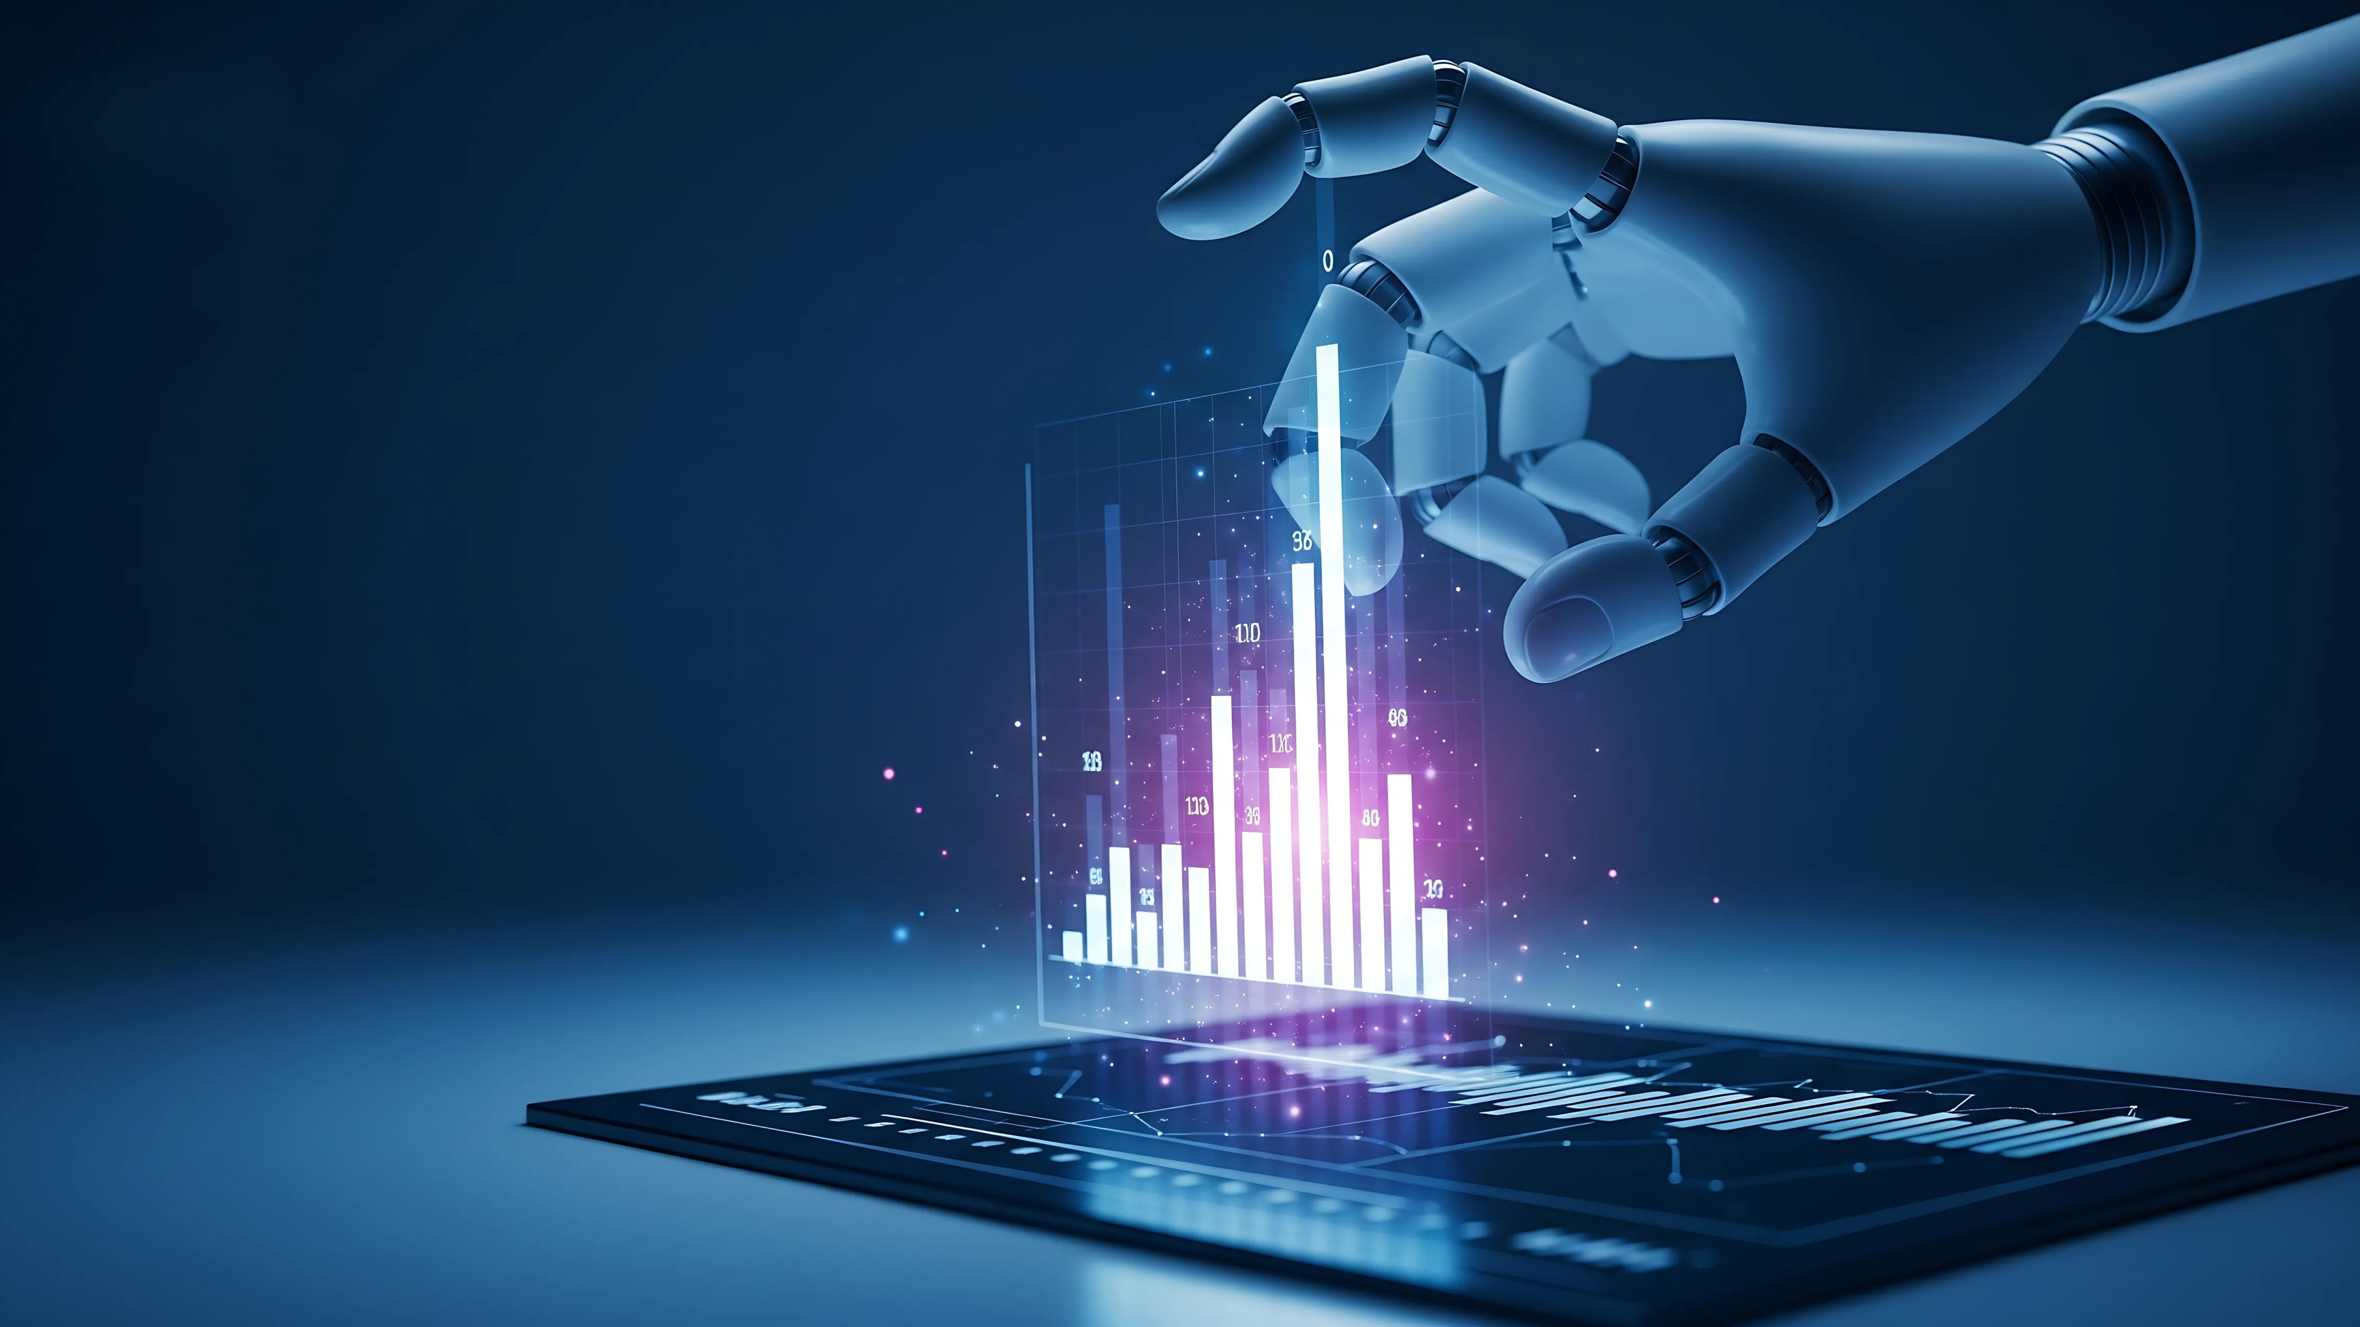
The Promise of AI in HR and Business

Slide 11
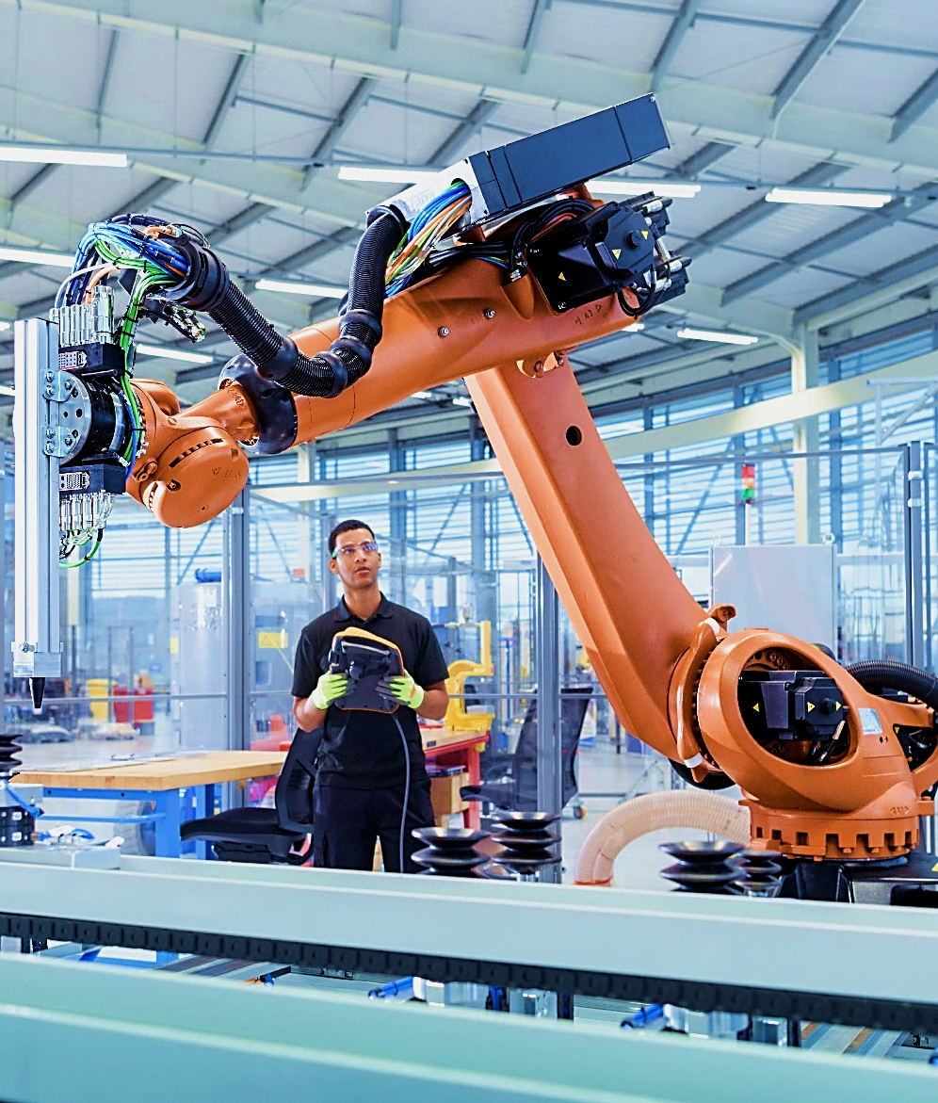
What AI Can Do for Most Companies
Efficiency & Automation
Automating repetitive tasks (e.g., resuming screening, scheduling interviews)
Streamlining onboarding and employee communications

Slide 12
Data-Driven Decision Making
Predictive analytics for hiring, benefits administration, retention, and performance
Personalized employee experiences through data insights
Examples of this being successful: AI tools that look at benefits usage from previous years, summarize what was actually used and provide tailored recommendations for benefits plan selections

Slide 13

Enhanced Employee Experience
Chatbots for HR support
  Agentic AI tools that feel human are making this more and more prevalent
  AI-powered learning and development platforms
  Customer Service
    Chatbots for CX support
      Again, agentic systems are big players

Slide 14
The Challenges and Risks
    Industry Pushback and Adoption
      Skepticism Across Sectors
        Trust issues with AI
        Not all industries are ready. Many concerns around privacy
Encourage
Wise
Investment
90%
Of AI investments yield zero/negative ROI
(MIT Study)
Notes:
Script:
“Across the market, reports this year claim most GenAI efforts show little measurable return—what MIT dubbed the ‘GenAI Divide.’ Take the exact percentages with caution, but the pattern is consistent: weak ROI when projects lack clean data, production-grade orchestration, or governance.” (TechRadar)
What fixes it: “Pick processes with owned data, instrument the workflow, and require vendors to pass governance gates before scale.”

Slide 15
Challenges to Consider – Discussed at National Level by Compliance HR Experts
Bias and Fairness
  Biases are not being addressed at scale. According to The Wall Street Journal, “ As use of artificial intelligence becomes more widespread, businesses are still struggling to address pervasive bias.”
Notes:
Reference the Workday suit.
It’s going to Supreme Court
What facts the decision could hinge on
How this has impacted AI adoption in HR
Script:
“Employees are excited and anxious—roughly half fear AI will replace their jobs, even as many want to offload drudge work to AI. Your job is to be transparent about what the system does, where human review sits, and how people are up-skilled.” (Microsoft)
Manager tip: “Publish an AI Use Policy, log models/agents, and tell employees exactly how their data is used.”

Slide 16
    Transparency and Trust
      “Black box” problem: decisions made by AI that are hard to explain – this is true for older AI.
      Building trust with employees around AI use
    Cost and Complexity
      Financial investment and technical expertise required
      Integration with existing systems and workflows
49%
Polled by Microsoft fear losing their jobs to AI; employee buy in is increasingly hard to get
Notes:
“Agentic systems don’t just chat—they take actions across your stack (ATS, HRIS, LMS) with approvals and audit trails. IBM calls this orchestration: secure agents that plan, call tools, verify, and hand back results. This is where you’ll see step-changes in cycle time.” (IBM)
Guardrail: “Treat agents like interns: least-privilege access, segregation of duties, and full activity logs.”

Slide 17

    Legal and Compliance Concerns
      Data privacy (e.g., handling sensitive employee data)
      Staying compliant with labor laws and AI regulations
Notes:
Script:
“Agentic AI can go off the rails without controls—objective drift, tool misuse, data exfiltration, and prompt-injection are real threats. Treat agents as identities: provision access like a user, rotate credentials, and continuously monitor actions. Build against the NIST AI Risk Management Framework and require vendors to show alignment with it.” (NIST Publications)
Evidence to share: “Security orgs report unintended agent actions and low policy maturity across enterprises—governance must catch up.” (TechRadar)
Emerging research: “Anthropic’s ‘agentic misalignment’ work highlights how models can choose harmful actions without explicit prompting—reminder that human override isn’t optional.” (Anthropic)

Slide 18

    AI Fatigue
      Data privacy (e.g., handling sensitive employee data)
      Employees are increasingly exhausted by a deluge of AI infrastructures and lack of proper training and onboarding.
      Employers cannot keep up with constant upskilling, leaving a gap in who understands the tech stack vs who actually uses it.
      According to research from Wiley, 75% of employees lack confidence in utilizing AI, while 40% struggle to understand how to integrate it into their work. The disconnect between executive enthusiasm and employee readiness creates friction throughout organizations and lack of proper training + on boarding.
Notes:
Script:
“On ASI, reasonable experts disagree on timing, but the direction is exponential—capability jumps compress planning cycles. For HR, that means scenario planning now: skills re-mapping every quarter, severance/reskilling reserves, role design that pairs humans with agents, and ethics triggers for surveillance or performance automation.” (YouTube)
Leadership move: “Publish your ‘human-at-the-center’ principles, define tasks off-limits to AI, and create a standing AI Safety Council with HR, Legal, Security.”

Slide 19

Only 3% said their ROI from AI was “substantial” growth
3%
Notes:
Recruiting (Today): Skills-based ranking, structured outreach, interview scheduling → measurable cycle-time cuts. Hype: ‘One-click hiring.’ Demand auditable criteria & fairness testing. (Eightfold)
Ask-HR (Today): Policy-aware chat + ticket deflection with human handoff. Hype: ‘Zero-human HR.’ Keep humans in the loop.
L&D (Today): Personalized paths from role/behavior data. Hype: ‘Replace managers with coaches.’ Use AI as a copilot. (Chronus)
Agentic Orchestration (Soon-to-standard): Secure multi-tool workflows with governance (e.g., IBM watsonx Orchestrate). (IBM)

Slide 20

What’s on the horizon for AI and small businesses
  Agentic workflows – c-suites at bigger companies are already talking about how agentic workflows can replace entire teams, so unpack what this could mean for SMBs, business owners, and teams.
Notes:
Script:
“IBM’s lens: trust first—governance, transparency, and risk controls before scale. Diamandis’ lens: think exponentially—pilot where upside is 10x, not 10%. Combine both: small, well-governed pilots that you can scale quickly when data proves value.” (YouTube) (YouTube)

Slide 21

AI Frontiers that Excite Us
AI Mineral Discovery + Automated lab experiments
AI in Pharma (drug discovery + protein design)
Robotics foundation models + factory deployments
Autonomous pricing + negotiation tools for supply chain
End-to-end software agents
Self-driving cars
AI-accelerated law firms
GenAI for fraud detection in real-time
Space exploration and AI pilots!

Slide 22

Key Takeaways:
AI is a tool, not a threat…
HR is uniquely positioned to benefit from AI
We can learn from the successes of other fields
Vensure is leading with thoughtful, process-driven innovation
WHAT ARE YOU DOING?

Slide 23
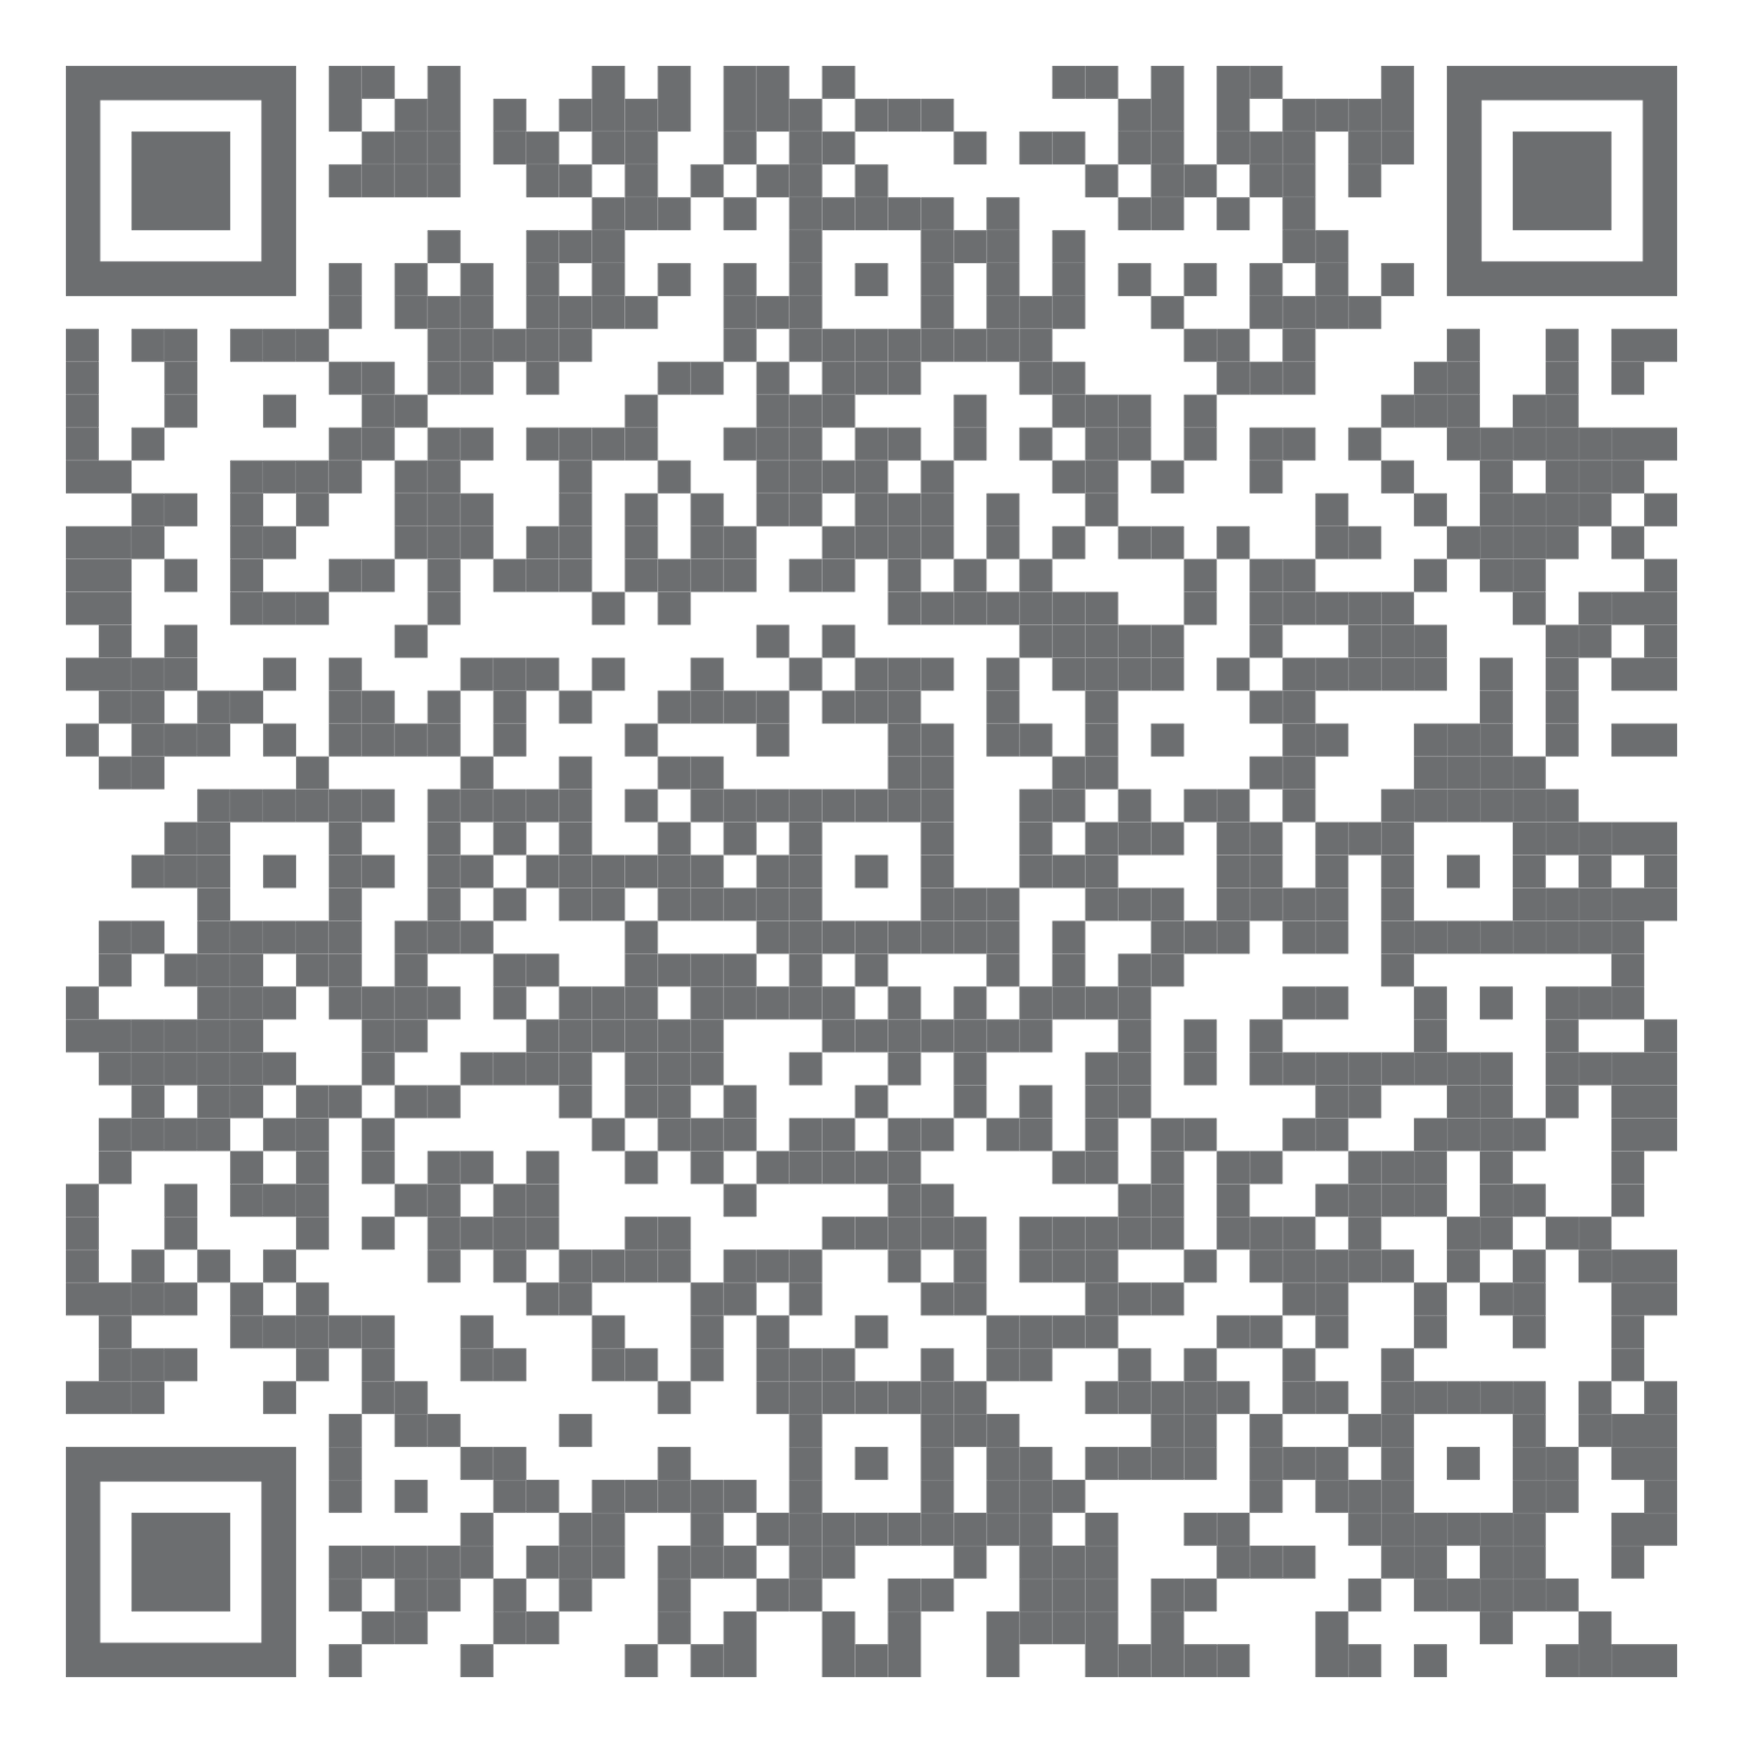
Thank you
for your time.

