Slide 1

HR Without Boundaries
Rethinking Organizational Design for a Dynamic Workforce
Notes:
What makes the workforce dynamic… is it the location, the development or evolution of their skills,
Perhaps it’s the mindset that drives their interaction, the relationship, and workflow connection points?
When and where does HR lean in the Organizational Design process?

Slide 2

Today’s Topic
Organizational Design and Where HR Makes an Impact
We will dive into how HR can re-imagine the boundaries so they can influence the design of agile, inclusive, and high performing organizations. It all starts with what you know…
Notes:
Today we are going to talk about Organizational design and how HR can re-imagine the boundaries so they can show up well, make a difference, evolve and be a necessary business partner.
It really starts with what you know…

Slide 3


Today’s Agenda
01. What is Organizational Design All About?
02. Organizational Designer Mindset
03. Removing Boundaries for HR
04. Organizational Culture Post- Organizational Design Project
Notes:
Designing organizations is a whole series of steps from discovery, project scoping, goals and strategy, to analyzing structures and people within those structures to then architecting and implementing…
On an administration front, there are so many factors to consider, communications, talk tracks for team meetings, people structure and realignments, notifications and job knowledge transfer or cataloging your process maps, workflows and standard operating procedures…
Today how HR Professionals breakthrough boundaries during the discovery phase that may silo them—so let’s dive!

Slide 4
Organizational Design
Notes:
Lets briefly define Organizational Design.
We will not spend a lot of time here, as we want to get to the good stuff on how you as HR Professional can make a difference!

Slide 5

Defining
Organizational Design
Aligning structure with an organizations purpose and environment.
Intended to inform the choices of how to organize and manage intuitions and serve the leaders who have been entrusted with the stewardship of these institutions.
Galbraith: Designing Organizations (2014)
Notes:
Jay R. Galbraith, professor, consultant and founder of Galbraith Management Consultants defines organizational design as…
Aligning Structure with an organizations purpose and environment…
Organizational Design Process… the process… is intended to inform the choices of to organize and manage institutions…
And to serve leaders who have been entrusted with the stewardship of these institutions.
I want to underscore this there to serve leaders who have been entrusted with the stewardship of these institutions… HUGE responsibility and can you imagine the everyday decision that go into that…
Let’s hold onto this idea- because I have some really-- interesting stats and perspective to share here that may inspire how you show up as an HR partner.
Organizational Design is not new… as long people have walked the earth, and formed and organized their groups, technology of their time to get jobs done to sustain, design and thought has existed… think about it! Think about how people procured food and evolved their process from the Jumpkill method
Now modern organization design as defined by Galbraith,
teaches us in his Designing Organization text … Modern organization design was evident in the 1950’s and by the 1960s there were formal definitions of Strategic organizational design
Lets go further to round out this section.

Slide 6
Organizational Design
Strategy
Structures
Environment
Traditional, Functional, Divisional, Matrix, Flat, Team-Based, Circular, Network, and more.
The operationalization of the firm’s goals of efficiency and/or effectiveness
The external: What could have an effect on the way in which an organization performs, such as regulations
Burton, Obel, Hakonsson: Designing Organizational Design (2021)
Notes:
Organization design includes Structures such as, traditional structures where many organizations start.
Functional structures where groups of employee by specialized roles, like marketing, finance… operations.
Other structure include divisional, matrixed,
Or flat with few or no levels of middle management…
Organizational Design Strategy is the in basic terms the operationalization of the firms goals… choices. There are dimensions of strategy that we can go deeper on, but it will take us away from our goal here and I know you are excited for the next segment.
And Organizational Design considers the environment and in large part determined by its environment. Lets go one step further.

Slide 7
Organizational Design
Drivers
Multiple Stages
People
Consumer behavior, product lifecycle, product or service performance, competitors…
Organizations All Start in
One Place
Evolve!
Drive work that gets done.
Notes:
Regulations, consumer behavior, product lifecycle, product or service performance.

Slide 8
Organizational Strategy
Organizational Design
Business Operations
Business Decision Makers
HR Practice
HR Influence
Notes:
Ordesign drivers requires require a coordination of development of products and service, operations, marketing, procurement, sales, finance and human resources to conduct normal business. For existing products on the market
Designing organizations book by Jay Galbraith is an excellent start to your Org Design specialty journey!
So, as you can see HR plays a very important role in the dynamic of organizational design.
Let’s get into how you can remove boundaries so the you can help design the best organizational structures with your partners!
First know that your superpower as an HR Professional is the ability to influence and one of the best ways (not the only way) to do that is to build trust, and credibility.
Helping Navigate Change
Understanding the work that needs to be done
And know the skill and behavior needed to the job done
These key drivers to building credibility which enable you to influence.
On the topic of trust- this is definitely an art and is the first step, and while this session is not about building trust some of the methods we will discuss today will help you in trust building skills

Slide 9
HR Footprint on Org Strategy
  Assess the Needs of the Organization (Linked to Strategy) and Helps
  Acquire
  Develop
  Position
  the Best Possible Talent…
  Culture
  Motivation
  High Performance
  Memory and Know How
  Cost Control Efficiency
  Vanish Operational Friction
Geary: How to Be a COO (2024)
Notes:
Jennifer Geary writes in her book How to be a Chief Operating Officer, that good HR will help foster a strong company culture.
And so what do matters and your footprint can be strong. Now lets talk about how to get there in the organizational design process or strategy.

Slide 10
Organizational Designer Mindset
Notes:
Organizational Designers focus on the fundamentals.

Slide 11

Business Curiosity
Know Your Business
What is the value proposition of the solution your organization is selling?
What is the operation of the business?
Necessary Work
  Activities to Get End Results
  Workflows
Job Roles and Responsibilities
  Skills
  Behaviors
Decision Points and Workflows
What Works and Why it Works?
Notes:
Org Designers spend a great deal of time here understanding the internal business operation.
Essentially understanding the structure of each function to understand how it interaction with the greater organization and connection points in the ecosystem.
Who does what? Where, why, and what systems are you using?
To break through boundaries so that you can influence org design you have to Be a student of the business to understand the context of the business to help strategically position or influence design of the desired target operating model.
But wait there is more! Once you know the business, stay curious…

Slide 12
Stay Curious
Know the Business Strategy
One Year
Multi-year Road Map
Brand Standards, Perceptions, Intentions
Mission, Vision, Values Alignment
New Customer Acquisition
What are you trying to maximize or minimize in your solution offering to your customers?
Industry Standards or Legislation Impact
Tools, Resources, and Budget (Not a Primary Factor of Future Organizational Design)
Notes:
Stay Curious by knowing the business strategy.
Understanding the structure of each function to understand how it interaction with the greater organization and connection points in the ecosystem is essential, and now the strategy is equally as important as this likely to change more often.
Industry standards and legislation impact:
If in 2030 electrification
Todays structure has invested in gas, training, meetings, operational tools and further training on those tools to deliver the product to the customer, customer acquisition costs…
Are there skilled trained pro’s for the future? Where will find them?

Slide 13
What are the Intentions of the
Organizational Design Project
What are you solving for?
  Slow and Steady or Bold and Transparent
  Target Audience
  Necessary Information
  Talk Tracks
  Objection Handling
What Needs to Change for Efficiency and Effectiveness
Cost Control
New Target Markets
Funding Rounds
Legislation and Industry Impact
Consumer Behavior
Building Trust is Key
Notes:
This is more than just the intentions of the or design project. But equally as important on how you will go about gathering the information…
Consumer behavior is interesting: If Generationally the workforce is different, perhaps their mindset on purchase and investment is different…
We talked about building trust earlier- you will need to pull the thread in real strong here.
Before you gather information from anyone you have to build trust and of course the strategy to know what you what info you are going after
Coming in and just asking questions with no context or visibility to your intentions will not get you far or valuable information. Authentically and mindfully get to know people thier work driver, work passion and footprint to build trust.
Sure it’s a delicate balance you get to know people and where they are from and their whole life story… steer the conversation for relevant topics.
Ask for introductions with clarity on the agenda.

Slide 14

Build Trust
Mindful
Mindsets
Sentiments
Capability
Emotional Intelligence
Transparency
Social Capital
Present Conversation—Future Impacts
Communication Frequency
Notes:
Organizational Designer build trust and mindful of …
This is necessary, as they have to be very inquisitive, and this along can make people uncomfortable…
Ask for introductions with clarity on the agenda.
If the goal is to evolve the organizational structure or design lets look at the a couple of general approaches. If the approach is to be silent you have to be creative in how you gather info. Know the mindsets in the organization before you start to ask questions…
Sure you can conduct a survey, have formal round tables, informal listening sessions on the ground flow. But this can be disruptive- its best be natural in the regular and consistent presence as an HR profession constantly be inquisitive and gathering info be up front and present. And document your info into categories and align.
If you are going to be bold and state we are changing our org strategy its critical to be transparent… to bring people along so that its not uncomfortable or disruptive … invite to participate in the initiative. Welcome ideas – it will help stabilize your workforce.

Slide 15
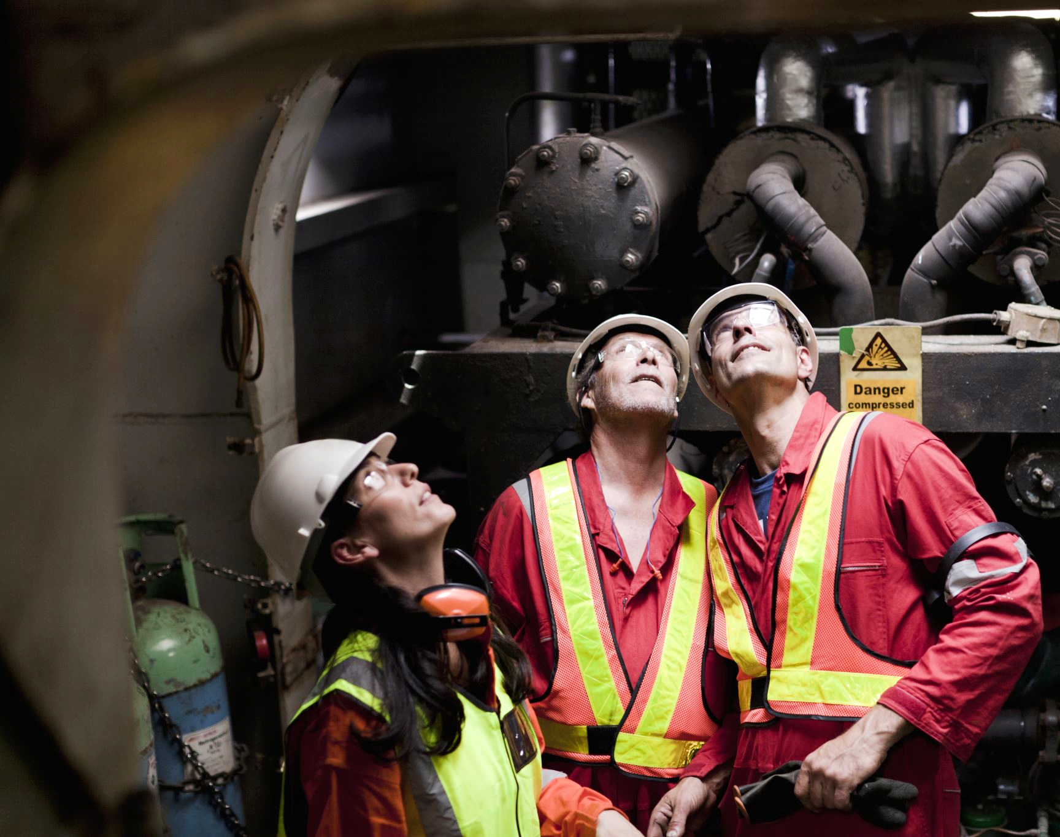
Building Trust with Decision Makers
    Enable Decision Makers
    Come Prepared
    Give Options
    Competitor Insights
    Legislation Impacts
    Industry Shapers
Notes:
Proven vs Just given
Lets pause here for a moment. When you release that pressure of having to decide, it allows you as an HR partner to be necessary, relevant and invited back.
Know what is impacting your industry. Lets take for example legislation that says Logistics companies must be fully electrical by 2030. This changes the competencies needed to be job ready, this could also have a major impact for designing your structure. Think about it.

Slide 16
Help Keep the Focus Approach is Everything
    Timing​
    Relevant Data
    Insightful Points at the Right Time
    Reinforce and Compliment
    Make Space
72%
of business leaders admit the sheer volume of data has stopped them from making a decision.
Oracle (2023)
Notes:
Or Designers Help Keep the focus with your audience and decision makers especially when you have the floor
Is your intention to teach, inform or support.
Too much information could be overwhelming
What do I mean by this… There is a time to teach method and a time to just do, because the decision makers are the business leaders— Making org design decisions take courage and those operational leaders sometime are just creating the blueprint for business they are in and in the climate of the environment and they need a partner they can trust and them feel supported.
Organizational design methods are essential for crafting and designing organizational structures
Activity session should drive activity on building Org Structure Strategy
Leave Learning lessons on Org Strategy Methods for other conversations
Compliment at the end of the session how the ideas aligned with Org Design Methods— as this builds confidence with leaders or decision makers

Slide 17
Solving the Right Business Problem
Product Offering Relevance
Systems
Workflows
Behaviors
Decision Layers
External Factors
Notes:
As an HR Partner you are always going to pull through the people component, its what most business partner look for when they pull you in to design.
Where you elevate and show up differently is what you lead with in your perspective. Remember organizational design aims to solve the right structures to get the job done for your company’s purpose
So now that we have looked through the mindset of an organizational designer in the discovery phase, hopefully this will inspire your approach to breaking through boundaries, you will be much stronger in doing so, buy knowing important details of your business.
Lets go deeper!

Slide 18
Removing Boundaries
for HR Partners
Notes:
HR Partners will play a part in org design work- pull data on people. People discussions…
But to be part of the discussion in the full cycle of the org design work goes beyond these conversation
There is opportunity for HR to be part of the full design work project if we are bringing the relevant dialogue for the point in time the org design step.
And what I mean by this, is that many leaders know there are compliance complexities, and people culture balance that needs to happen. In those moments where the business and business leaders are considering organization re-design or design the mindset is focused on the solution they offer their consumers and how to get it done… and also the weight of those decisions are heavy and pervasive.
Now this is just a tip… a reminder to remember that the topic – org design requires the thought threads needed in that context to pull through and stand out a little stronger
This is not to dim the other threads as any less important… because again- People Culture MATTERS… HR operational practices matter
Removing Boundaries is about removing blinds spots so that you can be invited to design for flexibility
We need strong people culture
We need employees bought in to vision
Employees perform when they are aligned
Performance is maximized when employees are engaged
Invest in developing employees
Compliance factors influence decisions throughout the lifecycle
When we push the notions set in bullet points as drivers to creating the best organizational design we may miss critical factors and in the rest of this session we are going to dive deeper in how to.

Slide 19

“…of business leaders have suffered from decision distress — regretting, feeling guilty about, or questioning a decision they made in the past year.”
85%
Oracle (2023)
Notes:
In 2023, a study conducted at Oracle aimed to understand the psychological and operational impact of modern decision-making and explore how overwhelmed people, primarily business leaders, feel when making decisions in an increasingly data-saturated world.
Now if you remember I said it earlier- Leaders are enstrusted as stewards of institutions… Huge responsibilities and big decisions… All heavy.
Decision Distress refers to the emotional aftermath of making a decision. Leaders are often bombarded with data, making the decision-making process feel uncertain, especially when it can impact many people (employees, customers, shareholders).
The pressure is INTENSE. This type of distress reduces confidence in future decisions and can impact the leader’s effectiveness over time.
Pretty incredible to see such a stat, and such doesn’t mean we have the wrong leaders in place,
they are human and signed up for the responsibility, and tough decisions come with the territory– but again human
And just like any artist so close to the canvas, they need a strong partner to help to look at the canvas from multiple perspectives, not a partner to call the obvious but a partner to bring fresh thought.
AND the great news, you can be that

Slide 20

How to
Remove
Boundaries
  Mindset Shift
  Curiosity of Business Solution and Why it Exists
  Customer Profile and Customer Experience
  Operation, Work, and Jobs
  Roadmaps, Vision, and Relevance
Notes:
How can we remove boundaries for our selves as HR Professionals, because its not always that someone is going to dust off the chair for us to sit at the table.
We all have a responsibility as an employee to prove our capability and showcase what we can do to build trust to get an invite…
Small business or large established… Org designs considerations are necessary, and the dialogue is varied…
It’s a given that HR may be invited when there is a job description, comp analysis, job offer, disciplinary action, or term- benefits strategy… and HR Strategy on Talent Management and talent acquisition… However at the Org Design table it requirement a Design thinking hat and strong operational threads.
When is comes to org design- the business leaders should be the ones to drive as they now the business and operations.
Its like conducting Needs Assessment:
Understand goals and current situation factors
What needs to stand out at the end and what resources can you do it with?
Is the business set up for success?
The HR Agenda in some organizations with People Culture is People first… Many of us have lived our passion to do what is right for our people and it all matters! Strong people culture can lead to strong performance outcomes.
When it comes to Organizational Design you have to pull to the front a strong business alignment and take a business first approach.
Business Alignment: Is the process by which we assess whether a company is set up to deliver on its strategic goals
Deep Curiosity
Pull through the tools needed in the situation or Org Design

Slide 21
HR Gets Inquisitive to the MAX
    Ask the Right Questions:
    Demonstrate Curiosity Consistently:
    What are your working on, why does
    it work?
    How does it drive our strategy?
    How does it align to our customer
    value prop?
    What is getting in the way?
    Is there anything new happening or not happening in our business or industry?
Listening Sessions
Casual, Intentional Conversations
Document Findings and Connect to
Strategy or Ideas
Study Your Industry
Provide Insights Throughout the Session—Share What You Know
Notes:
As mentioned in the previous slide always be gathering info. Having a seat at the table takes work and credibility. THIS IS YOUR opportunity to SHINE and be invited back. When you can bring insights to the table that are specific to the business vs pulling through “HR trends” Remember the decision makers are HR hats in general. They are operating the business and looking at strategy, resources, and goals through that lense- So the more relevant the information the more invites you get.
Then once you capture their attention and build credibility you can then pull through your HR threads if needed.
If we are only talking about org design focus on the practice and activity and less on method definitions. You have to know your industry- we will unpack this more in minute, but first know your org design methods for credibility

Slide 22

Influence a Different Story
Accelerate Agility, Inclusion, and High Performance:
Multiple Narratives
Various Perspectives
Data
Options
Courageous Decisions
Honest About Resources and Capabilities
70% of HR teams "do not have dedicated HR staff or teams for digitization, culture transformations, or organizational design."¹
¹PWC (2025)
70%
Notes:
Price Water House Cooper released this stat in 2023 Remember Organizational Design is focused on the solution, work and jobs needed to deliver. As you examine what to change it will require you to look through many lenses and sometime out of the comfort zone in what we know as HR professionals but through strong business and operational lens
HR Professionals can tell a difference story… while Making an impact and accelerating agility, inclusion and high performance within organizations—we do this through data, perspectives so that business leaders can make courageous decisions.
HR professional have to have a strong sense of their capability resources and Capabilities
In many cases there are limitations on the HR side of the house to do more with Organizational Design for a number of factors, and so operating frequently with a designer mindset is critical to accelerative movement on right design.
Org design will require deep digging and creative solutioning that is an Art form so that you can influence decisions with organization designs… and you do this with the resources you have.
So lets get into the organizational designer mindset a little more to uncover tips on how.

Slide 23

Does Removing Boundaries Matter? It Depends.
The Critical Evolution of HR:
Alignment to and Addressing the Business Needs
Understanding Competencies Needed for the Future
Dismantle Silos
“You can’t move past your boundaries if you stay in them…”
- Stephanie DeSorbo
Notes:
In a recent conversation I had with a former CEO in Pharma, she said to me I have always seen HR to a transferable skill regardless of the industry the methods and work translate and are similar. Operator's in a business sometimes are very specialized and it narrows the playing field and options.
She further said I have always appreciated when my HR partner knew the business because I able to get what I needed, which allowed to do what I needed to do to make decisions and drive the business.
It’s interesting perspective that HR work translates… because as HR professionals we know and probably have seen where we favor or perceive HR talent fit based on experience within that that industry and through that one thing that holds true is business.
Removing boundaries is about having a deep sense of curiosity- its starts with know your business.
“You can’t move past your boundaries if you stay in them”
The seat at the table is not easy especially if you are trying to affect culture, influence smart organizational design strategies and meet the needs of complex workforce. Especially when that workforce is distributed or global and in some cases hybrid.
Dismantle the silos. HR isn’t in the other room or on the opposite side of the table.
Who is to remove these boundaries—is it a given that HR should be at the table?

Slide 24


Focus on Design Needs
Business
Know Your Business
Notes:
Don’t let current limitations influence – focus on knowing your business. With or without organizational design project, know your business elevates your dialogue and influence throughout the business.

Slide 25
Organizational Culture…

Slide 26

94%
“…of business leaders have changed the
way they make decisions [since 2020].”
Oracle (2023)
Notes:
Jumping back to the 2023 Oracle study: This insight reflects a major shift in how business leaders approach decision-making, largely driven by the global events of 2020, and technological changes.

Slide 27

Rebuilding or fostering an inclusive culture that supports centralized, distributed, hybrid, and global workforces in itself is complex, especially after an organization redesign.
Social and cultural nuances and norms influence the approach and how people perceive change.
And Now Culture
Notes:
To influence and manage that after affects of organizational design you have to understand the audience and how to communicate and follow up. Lets spend a little time on culture and perhaps rebuilding…. Its important to lean into global mindsets.
Social and culture nuances and norms influence your approach. But what is it?

Slide 28
Reframing and Influencing
Driving adoption of organizational design requires more than change management—
it starts with a global mindset.
Business
Mindset
People
Culture
Diversity
Pull Through Diverse Mindsets…
Notes:
Reframing or influencing adoption of organizational design strategies and outcomes requires a change management strategy…of course, but a global mindset first.

Slide 29

“Organizations that prioritize inclusion are 87% more likely to
make better decisions.
They feel better and perform better.”
87%
Deloitte (2024)
Notes:
When our employees were born, access to technology, values, opportunities all factor in this beautifully rich complexity. Understanding this first is key to
"Organizations that prioritize inclusion are 87% more likely to say they make better decisions. This powerful advantage highlights how inclusive environments don’t just feel better—they perform better. In fact, inclusive companies also see a 75% higher likelihood of turning ideas into products and often report increased revenue driven by innovation.“ Deloitte - 2024
Because the business still needs to run how will the employees embrace the change…

Slide 30

Decisions with Global Mindset Considerations
Cultural Curiosity
Geography
Different Standards
Rules/Terms for Engagement
Successful Tips
Strengthen Knowledge of Mindsets in Global Settings, Both Business, Social, and Professional
Maintain Shape While Being Flexible
Be Intentional
Business Savvy
Social Capital
Notes:
To influence and manage that after affects of organizational design you have to understand the audience and how to communicate and follow up. Lets spend a little time on culture and perhaps rebuilding…. Its important to lean into global mindsets.
Social and culture nuances and norms influence your approach. But what is it?
First you have Global mindsets.
Maintain the shape of your business while being flexible to embrace diverse mindsets
This will allow you to be intentional while create strategy for culture building post organizational design/ redesign

Slide 31
Building Intentional Organizational Culture
  Focus and Design
  Mission, Vision, and Values
  Showcase What Matters to Employees
  Employee-facing Programs
  Social Ecosystems
  Engagement Activities
  Key Learning Programs
  Reshape and Solidify
  Communication Strategy
  Customer Solution Value Proposition
  Leader-hosted Strategy Session
  30, 60, 90-day Check-ins and More
Notes:
Reshaping and Solidifying Strategy could be intentional
Employees want to feel like they are going to be invested in to be successfull> key learning programs can help build competency and confidence
We see you, we need you, we value you, what you do matters, your ideas, innovation and ways of approaching your work has inspired the work we do for our customers.

Slide 32
Wrap Up
Removing HR Boundaries with Organizational
Design Requires a Different Mindset
Business Focused First
Be Credible
Intentional Conversations
Build a Talent-first Around
High-impact Work
Keep the Future in Mind
Be Intentional When Building Organizational Culture
Notes:
Removing HR Boundaries with Organizational Design Requires a Different Mindset
Be Business Focused First
Be Credible
Intentional Conversations
Let the client solution, operation, work and jobs that need to get done drive what you need from Talent
Identify and work towards future state
Be intentional with organizational culture building

Slide 33


Thank You
Abraham Gonzales-Pollick | /abrahamgonzalespollick

Slide 34
